Slide 1

KUVEMPU
UNIVERSITY
JNANASAHYADRI SHANKARGHATTA
Kuvempu University
Project ON:-Brain Tumor Detection Using Deep Learning
PRESENTED BY :-
Sudarshan D
PRESENTED TO :-
Dr.PRABHAKAR C.J
Dept. of MCA and Computer Science
KUVEMPU UNIVERSITY
JNANA SAHYADRI
SHANKARAGHATTA

Slide 2
CONTENT
Introduction
Aim
Objective
Challenges
Application of the Model
Methodology
Conclusion

Slide 3
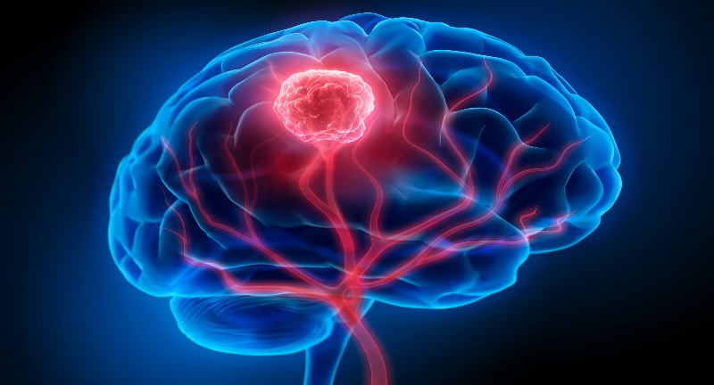
Introduction
A brain tumor is a lump or mass of abnormal cells that grows in the brain. Normally, the cells in our body grow and divide in a controlled way. But sometimes, certain cells in the brain start to grow too fast or in the wrong way, forming a tumor.
There are two main types of tumors malignant (cancerous) tumors and benign (non-cancerous) tumors
These can be further classified as primary tumors, which start within the brain, and secondary tumors
Fig 1: Visualization of a brain tumor highlighted in red within the brain structure.

Slide 4
Malignant:
  A malignant brain tumor is a cancerous lump that grows inside the brain.
  It is made up of abnormal cells that grow very fast and do not stop when they should.
  These cells can damage healthy brain parts and cause serious health problems.
  Malignant tumors are more dangerous than non-cancerous (benign) tumors
Benign: Benign (non-cancerous) tumors are abnormal masses of cells that grow in a controlled manner and do not invade surrounding tissues or spread to distant parts of the body like cancerous tumors do
Primary brain tumour starts inside the brain. It happens when brain cells grow abnormally and form a lump. It does not come from cancer in another body part.
Common types:
  Gliomas
  Meningiomas
  Pituitary adenomas

Slide 5
Gliomas:
Gliomas are one of the most common types of primary brain tumors.
They develop from glial cells, which are the supporting cells in the brain.
These cells help neurons (nerve cells) by providing structure, nutrients, and protection.
When glial cells start to grow abnormally and uncontrollably, they form a tumors called a glioma
Effect: May press on or damage brain tissue, affecting movement, speech, or vision
Meningioma
Origin: Meninges (protective layers covering brain and spinal cord)
Growth: Usually benign, slow-growing
Effect: Can cause headaches, seizures, or vision changes by pressing on the brain
Pituitary Tumour (Pituitary Adenoma)
Origin: Pituitary gland (controls hormones)
Effect: Can change hormone levels, causing symptoms like weight change, vision problems, or growth issues

Slide 6
AIM
The main aim of the brain tumor detection project is to develop an automated system using deep learning
that accurately detects brain tumors from MRI images.
It assists doctors in early diagnosis, reduces human error, improves diagnostic speed,
and supports better clinical decision-making for effective treatment planning.

Slide 7
Objective:
To build a brain tumor detection model using deep learning.
To pre-process the MRI images by removing unwanted data and resizing.
To use the VGG16 model for model training and classification.
To evaluate the performance of the proposed model by various performance metrics.
To create an interface where users can upload an MRI image and get the prediction result.

Slide 8
Challenges
High Initial Setup Cost
Buying sensors, machines, and software tools can be expensive.
Security and Privacy Issues
Automated systems can be hacked or misused.
Maintenance and Updates
Systems need regular updates, hardware checks, and bug fixes.

Slide 9
Application of the Model:
Medical Diagnosis Support
→ Helps radiologists and doctors detect brain tumors from MRI scans quickly and accurately.
Automation in Hospitals
→ Can be integrated into hospital systems to reduce manual image analysis time and workload.
Mobile & Web Health Tools
→ Can be deployed in mobile apps or web platforms to allow remote scanning and detection, especially in rural or low-resource areas.

Slide 10
Methodology
DATASET:
The Brain Tumor MRI Dataset is a collection of 7,023 human brain MRI images aimed at supporting research and development in brain tumor detection.
The dataset is composed by merging three different sources: the Figshare dataset, the SARTAJ dataset, and the Br35H dataset.
Figshare and SARTAJ contain MRI images labeled by tumor type
Br35H includes preprocessed and annotated MRI scans, supporting classification and segmentation tasks for brain tumor detection and analysis
Annotated MRI refers to MRI (Magnetic Resonance Imaging) scans that have been labeled or marked by experts (like radiologists) to highlight important regions—such as tumors, tissues, or abnormalities. These annotations can include:

Slide 11
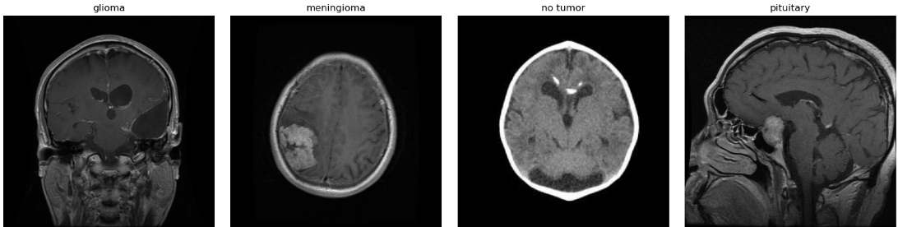
Here is the image count for each folder (class) in the Brain Tumor MRI Dataset:
Class | Number of Images
Glioma | 1,926
Meningioma | 1,937
Pituitary | 2,075
No Tumor | 710
Total | 7023
Fig. 2: Sample MRI Images of Different Brain Tumor Types and Normal Case

Slide 12
Manual class Balance:
Class | Number of Images
Glioma | 710
Meningioma | 710
Pituitary | 710
No Tumor | 710
Total | 2840
AUGMENTATION:
S.No. | Augmentation | Description
1 | Original | The original input image (no transformation).
2 | Rotate +25° | Rotates the image 25 degrees clockwise.
3 | Rotate -25° | Rotates the image 25 degrees counter-clockwise.
4 | Horizontal Flip | Flips the image horizontally (left ↔ right).
5 | Vertical Flip | Flips the image vertically (top ↔ bottom).
6 | Zoom In | Zooms into the center of the image (crop and rescale).
7 | Width Shift | Shifts the image left/right by a fraction of the width.
8 | Height Shift | Shifts the image up/down by a fraction of the height.

Slide 13
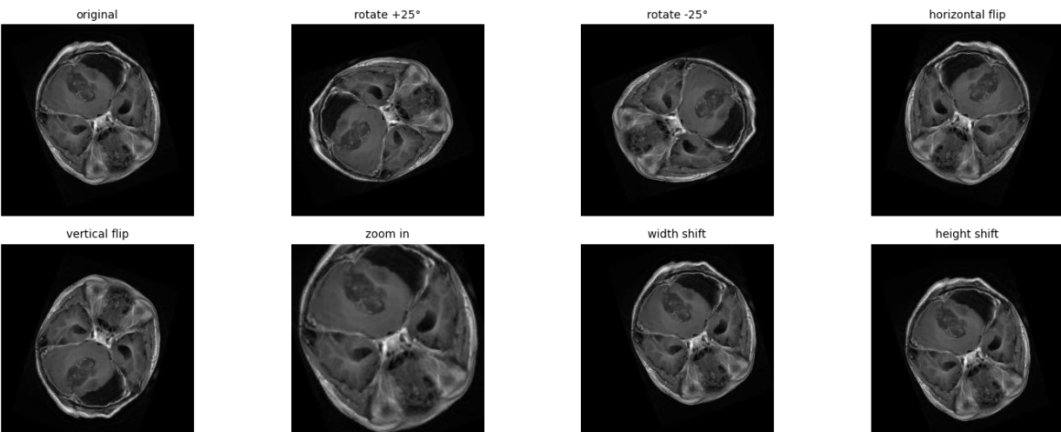
Fig. 3 Data Augmentation Techniques Applied to MRI Image

Slide 14
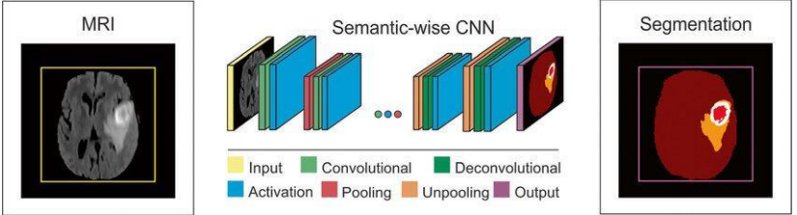
Working of CNN model
Layer of CNN model:
Convolution 2D
MAX Poolig2D
Dropout o Flatten
Dense
Activation

Slide 15
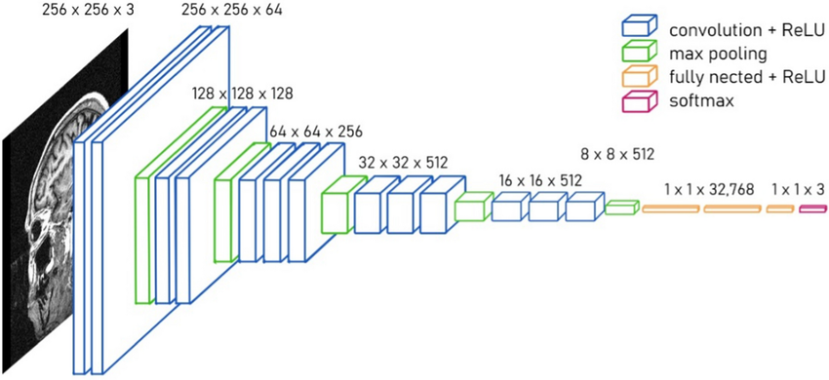
VGG16 MODEL
Fig.4 VGG 16 Model architecture

Slide 16
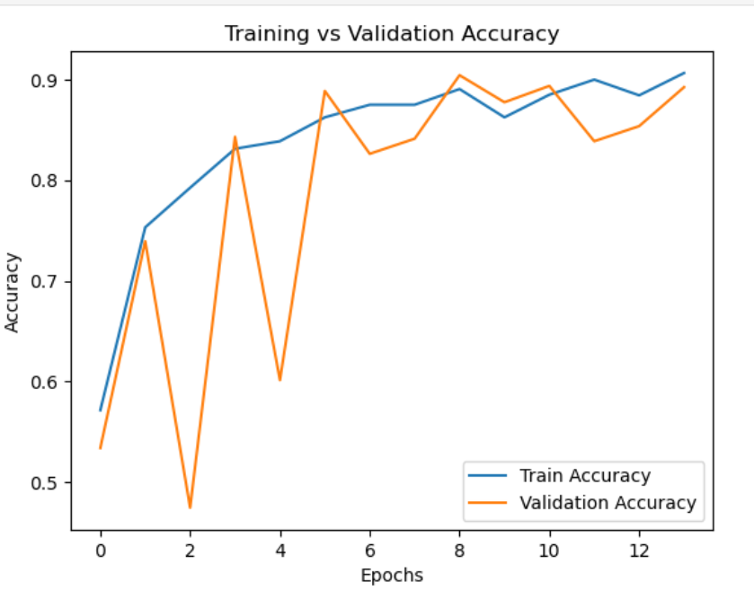
Result And Analysis
Training vs Validation Accuracy
FiG.6 Training vs Validation Accuracy

Slide 17
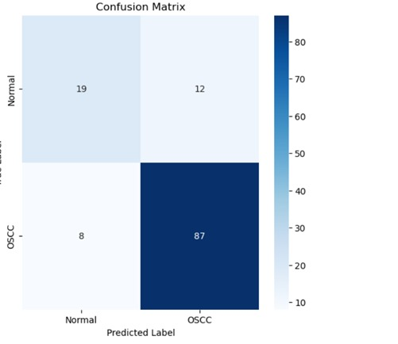

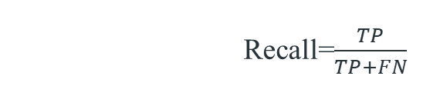
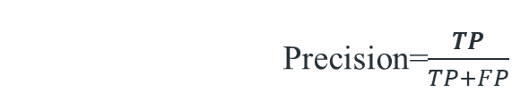
Improve the accuracy
Accuracy=$\frac{TP+TN}{TP+TN+FP+FN}$
Precision=$\frac{TP}{TP+FP}$
Recall=$\frac{TP}{TP+FN}$

Slide 18
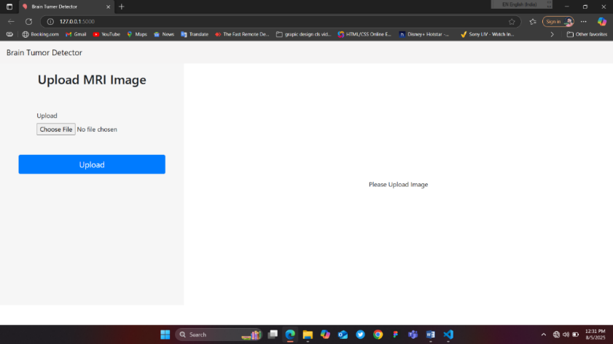
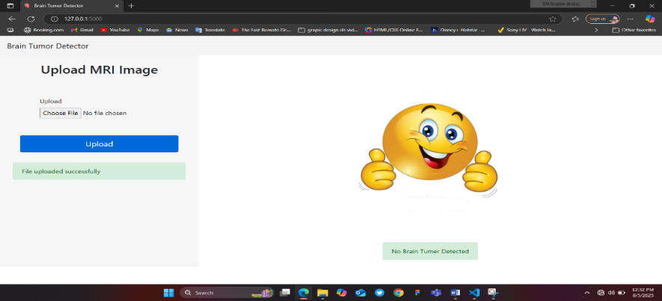
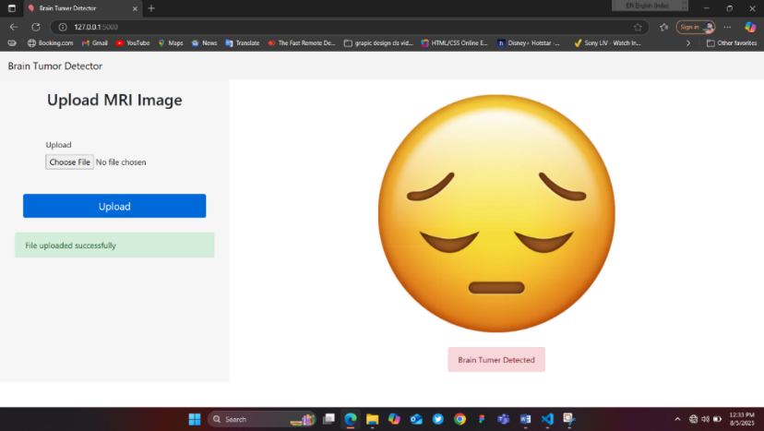

Slide 19
•True Positive (TP): The model correctly predicted a positive outcome i.e. the actual outcome was positive.
•True Negative (TN): The model correctly predicted a negative outcome i.e. the actual outcome was negative.
•False Positive (FP): The model incorrectly predicted a positive outcome i.e. the actual outcome was negative. It is also known as a Type I error.
•False Negative (FN): The model incorrectly predicted a negative outcome i.e. the actual outcome was positive. It is also known as a Type II error.

Slide 20
Conclusion:
In this project, a brain tumor detection model was successfully developed using deep learning techniques.
The VGG16 pre-trained model was used for feature extraction and classification of brain MRI images.
The model showed good accuracy in detecting different types of brain tumors after preprocessing and training.
An easy-to-use interface was also created to allow users to upload MRI images and get instant predictions.
This system can help doctors in early diagnosis and reduce the time required for manual analysis.
Overall, the project demonstrates the power of deep learning in medical image analysis and its potential in real-world healthcare applications.

Slide 21
THANKYOU…

